Slide 2
Hi there!
This is your very own pitch deck to help you get your company started with its journey towards fair pay.
There are lots of slides you can choose from and customize while building your business case.
PS. Check out the [grey text] to see where you can add your own information that fits your team’s current state and how you work.
Happy pitching!

Slide 3
What’s in your pitch deck:
Why pay equity matters and the ROI | Slide 4-15
Benefits of using technology for pay equity audits | Slide 16-18
Pay equity analysis and business goals | Slide 19-22
Pay equity business case | Slide 23
How Payscale Pay Equity software works | Slide 24-33
Appendix / Additional Resources | Slide 34-43

Slide 4
In 2021, women make only $0.82 for every dollar a man makes.
Source: Payscale gender pay gap report

Slide 5
Women of ethnic groups earn $0.75 for every dollar a white man earns.
Source: Payscale gender pay gap report

Slide 6
77% of white people were in employment last year, compared with 65% of people from all other ethnic groups combined, but wages vary among all ethnic groups.
Source: PWC

Slide 7
When asked whether or not they have a gender pay gap, 60% of companies claim that they do not. However, only 46% of companies say they plan to conduct pay equity analysis in 2021.
Source: Payscale pay equity & DEI report

Slide 8

Companies embracing a diverse and inclusive culture have a 22% lower turnover rate and a
22% increase in employee productivity.
[Check out our Diversity and Inclusion ROI Calculator by opening the Excel Worksheet below to see what reduced turnover and increased productivity could look like in $ for your own company]
Source: Deloitte

Slide 9
Companies that close pay gaps now will pay less than those who wait to take action, as the average cost to correct gaps increases by US$439,000 every year.
Source: Gartner

Slide 10

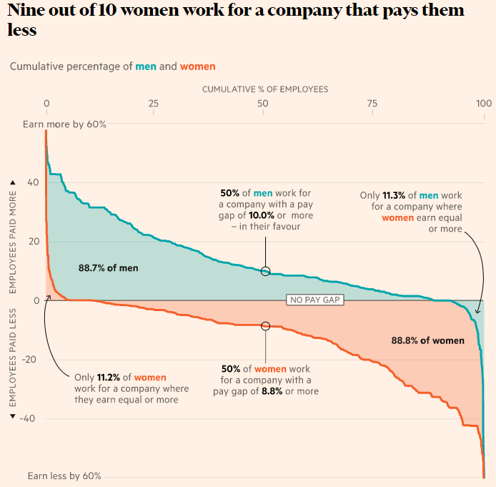


In the media
There is no longer any excuse for disparities in the wages paid to people of color and especially to women of color whose pay is twice discounted. Conduct a wage equity audit, and make the adjustments needed to achieve fair and equitable pay. For example, PayPal makes adjustments regularly throughout the year to maintain equity. Studies have shown that closing the racial pay gap would increase U.S. GDP by 14%, or more than $2 trillion. ¹
Gender pay equity has become a big point of contention at many companies. Not only have politicians and other public figures spoken out against the gender pay gap, but there has also been a rising tide of high profile lawsuits targeting major employers, most notably in the U.S., with all the bad publicity and financial liability they entail. ²
³
⁴
⁵
⁶
¹ Source: The 10 Commitments Companies Must Make to Advance Racial Justice – Harvard Business Review (June 2020)
⁴ Source: Black and Hispanic Job Seekers Still Face Wage Gap in Tech - Wall Street Journal (Sept 2020)
² Source: Why Companies’ Attempts to Close the Gender Pay Gap Often Fail Harvard Business Review (Jan 2019)
⁵ Source: Latina Women to Lose Out on More Than $1 Million Over Their Careers - Wall Street Journal (Nov 2019)
³ Source: Gender pay gap: how women are short-changed in the UK - Financial Times (Sept 2020)
⁶ Source: Even Google Can No Longer Hide Its Gender Pay Gap – The New York Times (March 2019)

Slide 11



Recent lawsuits alleging pay inequities have sought damages in excess of US$100 million.
“Uber agreed to pay $10M in March 2018 to settle a proposed class-action lawsuit alleging discrimination against 400+ women and minorities brought by three women engineers.”
“Tesco Action Group argue that Tesco has been paying female staff less than their male counterparts. The backpay they demand for this misdemeanour is £2.5 billion.”
“The union argued Canada Post’s 8000 rural carriers - most of whom are women - were being paid substantially less than their male co-workers.
The ruling translated into a 25% pay hike, plus some increased benefits, costing them up to $124,800,000 over 2 years.”
Source: The Guardian, Benefits Canada, Lawyer Monthly, ACC Docket

Slide 12
Top performing organizations have a higher rate of reporting pay equity as somewhat important or very important (72.2%) compared to non-top performers (63.1%).
Let’s be part of that majority.
Source: Payscale pay equity & DEI report

Slide 13
Let’s get real.
Pay equity has become a societal, economic and political issue. Most companies have a pay equity challenge, but don’t know the extent of it.

Slide 14
Pay equity has become key in business strategy and a regulatory compliance requirement.
Without it, companies have an increased exposure to litigation and brand damage.

Slide 15
What if you could prove your commitment to fair pay, minimize legal risks, and protect your brand reputation all in one place?

Slide 16
You can with
Payscale Pay Equity gives you the full picture
into your organization’s pay equity trends.

Slide 17

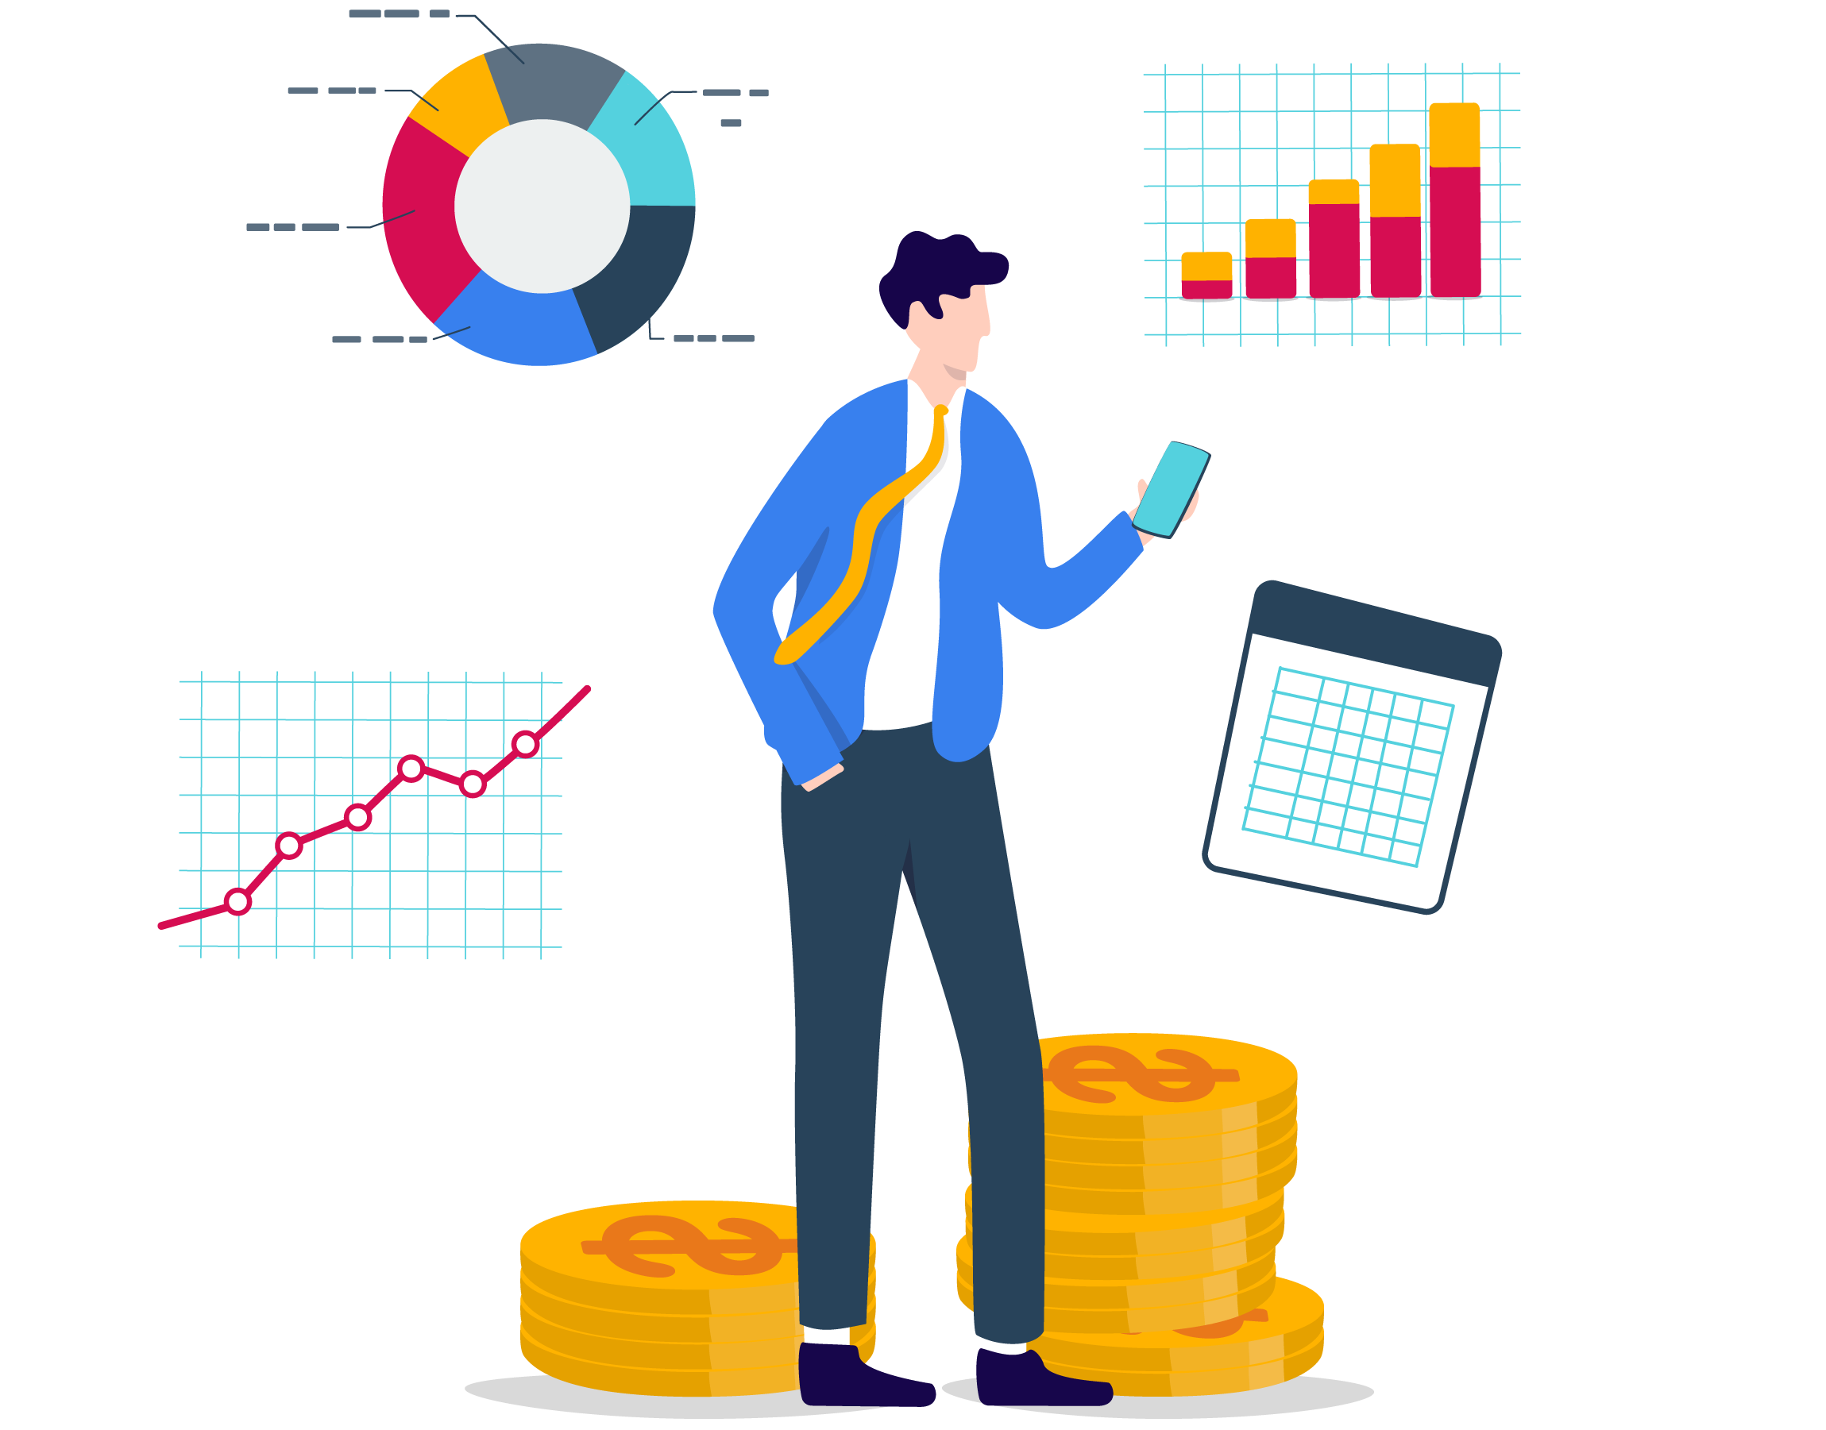
Life before Payscale Pay Equity
Life with Payscale Pay Equity
Minimal to no understanding of pay trends or gaps, and unsure where to begin without a pricey consultant or manual, time-consuming processes.
Pay equity is a priority with real time data insights at your fingertips, making it easy to stay up-to-date and take actions to resolve any equity concerns.

Slide 18
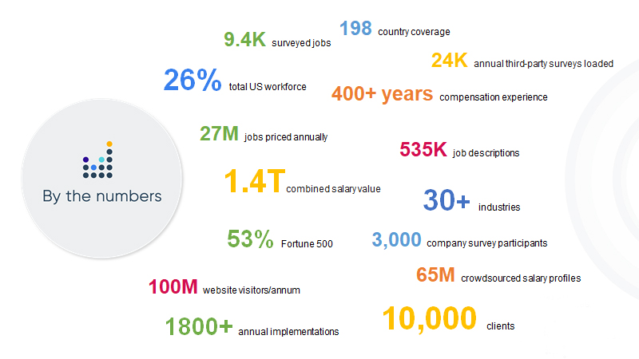
Payscale is...
The industry leader in compensation data and technology, helping organizations #getpayright. Payscale is the only tech solution for managing compensation that provides multiple streams of fresh, transparently curated and
validated salary data. Combined with modeling engines that learn continuously and generate recommendations and insight, Payscale empowers HR to price jobs and adjust compensation to reflect near real-time changes in the market — all on one trusted data platform.

Slide 19
Payscale will help us...
[pick the goals that matter most to your company]
Uncover pay equity trends in minutes versus months
Manage complexity with visual, intuitive software
Understand what drives pay variance and if it’s aligned to our compensation principles
Receive budget recommendations & calculate cost of pay equity adjustments
Track the status of pay equity actions or justifications
Perform analysis on an ongoing basis and keep team up-to-date with real time insights
Minimize risk of litigation
Create a transparent & inclusive company culture
Protect brand reputation

Slide 20
These are the types of analysis we can perform
[pick the types of analysis your company wants to do]
Pay gaps
Average pay of a main comparator group to the average pay of another group
Equal pay (uncontrolled)
Comparing similarly
situated employees in cohorts on an average pay basis
Equal pay
(controlled)
Comparing similarly situated employees after compensable factors that drive pay differences
are taken into account
Proactive Pay Equity Audit: Individual employee tracking & remediation budget modelling

Slide 21
These are the areas we can analyze
[pick the main categories your company will look at or make your own]
Global level
Basic pay
Gender
Race
Bonus pay
Country level
Veteran status
Total compensation
Ethnicity
Business groups
Sexual orientation
Stock equity
Disability

Slide 22
These are examples of trends we can see
[pick the key insights your company wants to gain]
Understand average pay differences by country or business group
Understand how representation impacts pay gaps
Understand how pay gaps impact different protected category groups
Compare how employees are
paid for the same or like
work within a location
Explore cohorts who share similar characteristics to identify outliers
Compare similarly situated employees after legitimate
factors driving pay differences
are considered
Run statistical modelling to investigate the factors that determine pay
Compare insights to identify required pay remediation
Compare the cost impact of different pay remediation scenarios

Slide 23

A business case for Payscale Pay Equity
Why do we want to use Payscale? What do we want to accomplish?
[Add your own use case here]
We plan to track progress over time for these objectives:
[Objective 1]
[Objective 2]
[Objective 3]
We will use these types of data analysis and focus areas to uncover pay trends:
[Analysis 1]
[Analysis 2]
[Analysis 3]

Slide 24
How Payscale Pay Equity works

Slide 25



These are the types of analysis we can perform
Uncover pay gaps in minutes
Average pay of a main comparator group to the average pay of another group
Understand costs and actions for remediation
Comparing similarly
situated employees in cohorts on an average pay basis
Create a sustainable approach to pay equity
Comparing similarly situated employees after compensable factors that drive pay differences
are taken into account

Slide 26
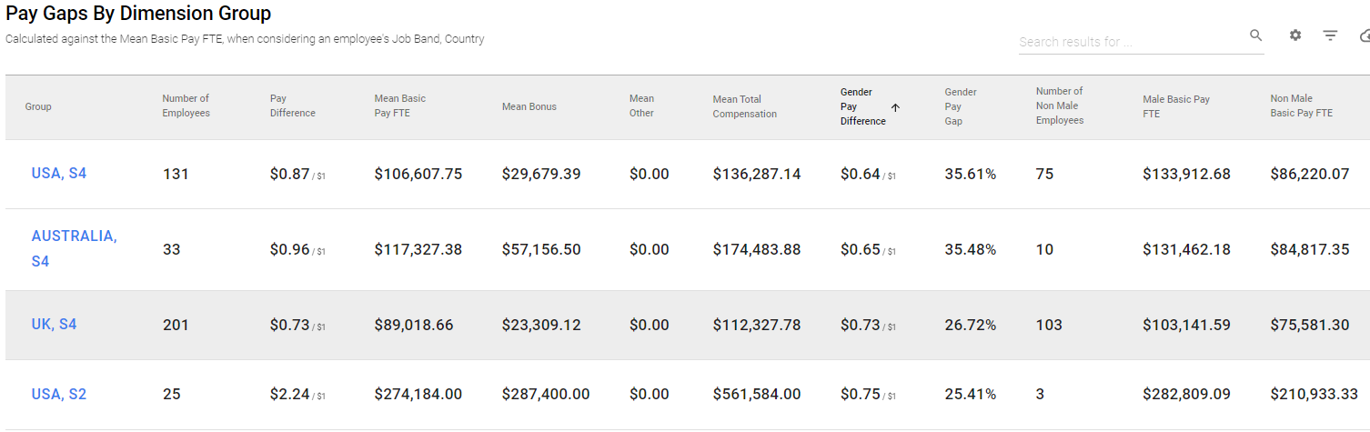
Key feature: Uncontrolled analysis
Analyze your data to understand how pay equality plays out, including representation and pay trends across varying levels, business units, locations and more to help uncover systemic issues that may exist.

Slide 27
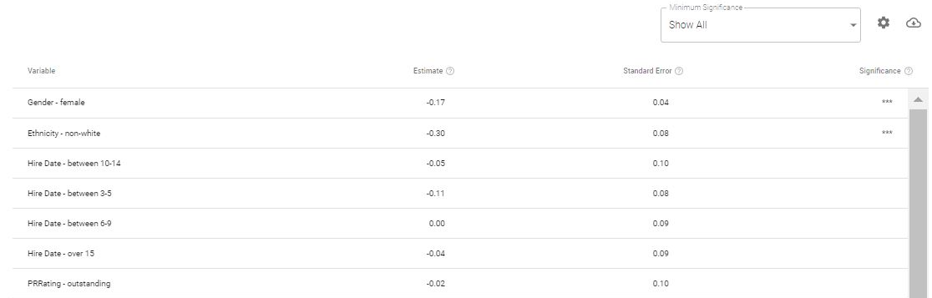
Key feature: Controlled analysis
Explore which factors drive pay variance and whether they are legally defensible and have the expected impact throughout the organization.

Slide 28
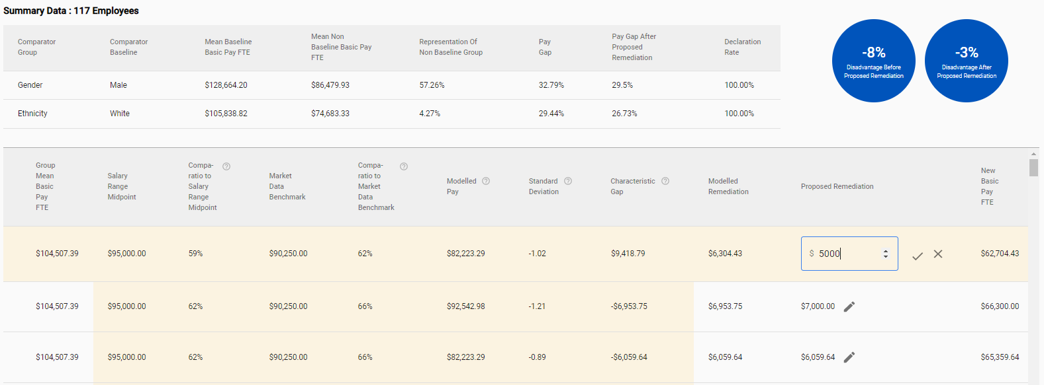
Key feature: Remediation and budget modeling
Group employees who perform equal or substantially similar work into pay analysis groups to contextualise statistical outcomes or explore other factors that may drive pay differences.

Slide 29
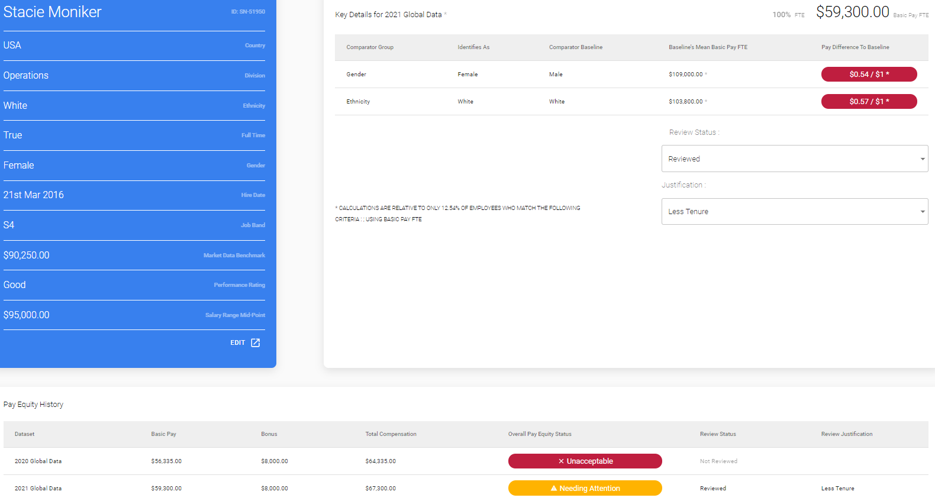
Key feature: Track employee specific outcomes
Develop remediation scenarios down to the employee specific level to give you a customized and flexible plan that works best for you.

Slide 30
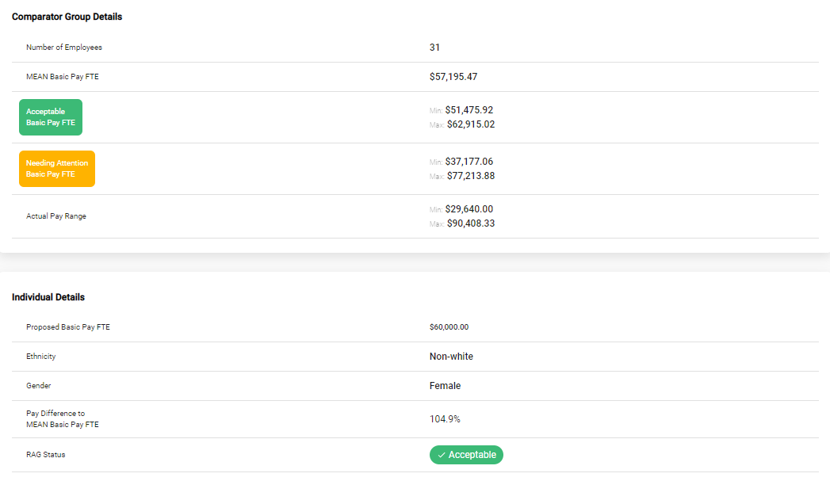
Key feature: Fair pay checks
Set the right pay at the time of hire, promotion, or role transfer by generating a custom query to identify the fair pay range for a position.

Slide 31
Key feature: Fair pay checks
Connect our data
Upload our data with a CSV file, built-in integrations, or APIs.
Choose our report
Pick from multiple reports including: cohort analysis, budget optimization, etc.
1
3
4
Create a data set
Figure out what we want to
compare using our data.
Share our findings
Export tables, graphs, and reports back into your HRIS or as PDF files.
2
4

Slide 32
Payscale is here for us
1
Product Onboarding Support
2
Consulting Services Support
1:1 how-to help from our specialists to guide you through initial set-up, with online functional training.
Consulting can include: developing goals of your pay audit, identifying what data is required, how to use the solution to meet these goals, etc.
Onboarding support is included in the annual license fee, with additional hours available.
Consulting Services support is included in the annual license fee, with additional hours available.

Slide 33







Questions?
info@payscale.com
@payscale
@payscale
payscale.com
+00-000-000-0000

Slide 34
Appendix
Some extra resources for building your business case

Slide 35
Business case examples

Slide 36
A business case for Payscale Pay Equity (example)
Why do we want to use Payscale? What do we want to accomplish?
Our video streaming software is booming, and our global team is growing quickly. With a need to hire additional software engineers and technical writers, we want to ensure we maintain a diverse and inclusive culture across all of our teams in order to attract the best talent around the world. With known gender pay equity issues in the tech industry, we want to proactively reduce the risk of pay inequity within our own organization and maintain a transparent, positive record on pay. This will help us keep our strong brand reputation both internally with happy, motivated employees and externally with future talent, press, and investors.
We plan to track progress over time for these objectives:
Perform analysis on an ongoing basis and keep data up-to-date at pace with hiring efforts
Protect brand reputation
Maintain a diverse and inclusive culture
We will use these types of data analysis and focus areas to uncover pay trends:
Perform pay gap analysis and both adjusted / unadjusted equal pay analysis
Analyze total compensation comparing gender by job groups, globally and by country
Analyze total compensation comparing race by job groups, globally and by country

Slide 37
A business case for Payscale Pay Equity (example)
Why do we want to use Payscale? What do we want to accomplish?
Gamification is encouraging more and more Americans to be active and put their health first. As a result, fitness wearables have increased - but so has conscious consumerism. Consumers care about how our business affects the environment, and they are only buying from companies who employ a diverse workforce inclusive of various gender, race, sexual orientation, age, etc. We not only need to care for our employees’ wellbeing to increase productivity and minimize legal risks - but also need our consumers to understand our non-discrimination hiring policies. Performing proactive pay equity audits and adjusted equal pay analysis on an ongoing basis will help us do that.
We plan to track progress over time for these objectives:
Eliminate any pay differences that are not due to legitimate business factors
Monitor average pay gaps as an indicator of potential bias and representation across the organization
Increased brand reputation to win over consumers
We will use these types of data analysis and focus areas to uncover pay trends:
Adjusted equal pay analysis
Compare pay gaps by gender, race, and sexual orientation in the USA
Compare pay gaps by gender elsewhere

Slide 38
Here’s the proof

Slide 39
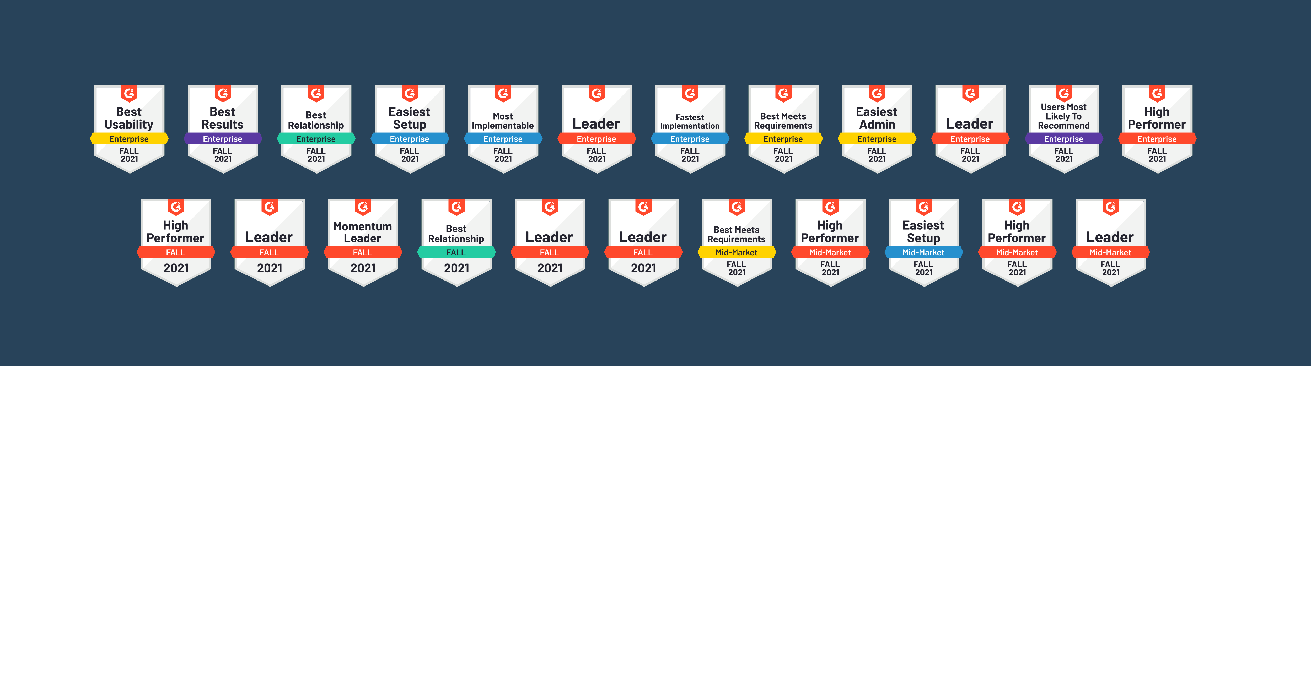
Payscale is the industry leader in compensation data and technology and the only technology solution for managing compensation that provides multiple streams of fresh, transparently curated, and validated salary data.​
Together, we’re delivering unrivaled usability,
performance, expertise and customer success.

Slide 40
“Payscale Pay Equity has helped to build trust and credibility with our staff and board by sharing results from our analysis and it helps make our annual pay audits a lot easier.”
“No other technology vendor supports us like Payscale. When I email customer service, it feels like someone is waiting on the other end for me to send in a specific request, like it’s their only job. When we have a tough role to price, like hybrid jobs where it’s difficult to match the right title, we can throw a request for help to the Payscale customer service team and get a specific, human response from someone with experience who says ‘hey, the job you are describing sounds like this job’. It’s such a time saver.
Tamara Lewis | Talent & Culture, Vice President | Conrad N. Hilton Foundation
“With Payscale, we have a trusted source for salary data as well as the right tools and technology for where we’re at in our journey – and where we’re headed. Payscale’s ability to grow and scale with us provides flexibility to go as fast as we want or as slow as we need depending on what our business activity is at the time.”
Wiley Osborn | Director of Human Resources | Intimidator, Inc.
Jimmy Griffin | Chief Human Resources Officer | Centauri Health Solutions

Slide 41
Data security

Slide 42

From spreadsheets to a secure cloud
Data security and integrity is critical when it comes to sensitive employee information
Distributed spreadsheets can expose organizations to the risk of major data breaches. Moving from spreadsheets to a secure, cloud-based solution will protect our data and ensure full GDPR compliance.
Features such as role- and permission-based access provide complete control over who can see employee data. This is critical when it comes to sensitive information like potential pay gaps and inequity within our company.

Slide 43

Star your journey
towards pay equity today.
See how our software and services can help you conduct analysis and manage pay equity over time to get pay right.
Request a demo

